Slide 1
Software Quality
Dr. Sarah Naiem

Slide 2
What is a Software
Software is not just the code that runs on a computer. It encompasses the entire system that allows the computer to perform specific tasks. According to the IEEE definition, software includes:
Computer Programs: The actual code written by developers.
Procedures: The step-by-step instructions that guide how the software should be used or executed.
Documentation: Manuals, guides, and other written materials that explain how the software works and how to use it.
Data: The information that the software processes, stores, or generates.

Slide 3
What is a Software
Example: Consider a mobile banking app:
Computer Programs: The code that allows you to log in, check your balance, and transfer money.
Procedures: The steps you follow to complete a transaction.
Documentation: The user guide that explains how to use the app.
Data: Your account information, transaction history, and other data stored in the app.

Slide 4
Software Error, Fault, and Failure
Software Error: This is a mistake made by a programmer during the development process. For example, a programmer might write incorrect logic or forget to handle a specific condition.
Software Fault: This is the manifestation of the error in the code. It’s a defect that exists in the software but may not always cause a problem.
Software Failure: This occurs when the fault is activated, causing the software to behave incorrectly or crash.
Example: Imagine a calculator app:
Error: The programmer mistakenly writes code that adds 1 to every result.
Fault: The defect in the code causes the calculator to give incorrect results.
Failure: When a user tries to calculate 2 + 2 and gets 5 instead of 4, the software fails to perform its intended function.

Slide 5
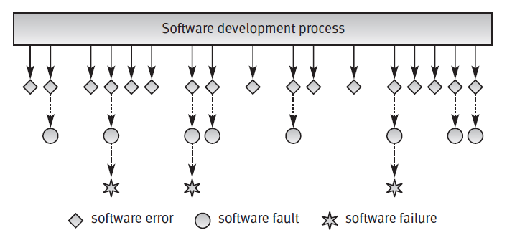
Software Error, Fault, and Failure

Slide 6
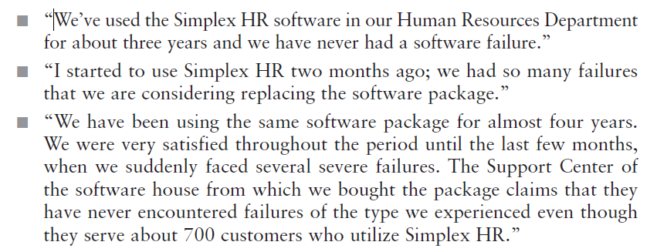
Software Error, Fault, and Failure

Slide 7
Case Study: Therac-25
Therac-25 was a radiation therapy machine used in the 1980s to treat cancer patients. Due to a software error, the machine delivered lethal doses of radiation to several patients, resulting in severe injuries and deaths.
Root Cause: The software had a race condition—a type of bug where the system’s behavior depends on the timing of uncontrollable events. In this case, the machine’s software failed to properly check the radiation dose, leading to overdoses.
Lessons Learned: This case highlights the importance of rigorous testing, especially in safety-critical systems. It also underscores the need for proper software design and error handling.
Key Takeaways:
Testing is Critical: Even small errors in software can have catastrophic consequences in critical systems.
Safety Mechanisms: Hardware and software safety mechanisms should be in place to prevent failures.
Documentation: Proper documentation of software requirements and design is essential to avoid misunderstandings.

Slide 8
Classification of the Causes of Software Errors
Faulty definition of requirements
Client–developer communication failures
Deliberate deviations from software requirements
Logical design errors
Coding errors
Non-compliance with documentation and coding instructions
Shortcomings of the testing process
Procedure errors (User error)
Documentation errors

Slide 9
Classification of the Causes of Software Errors
Faulty Definition of Requirements:
If the requirements are unclear, incomplete, or incorrect, the software will not meet user needs.
Example: A client asks for a feature to export data to Excel, but the developer misunderstands and implements CSV export instead.
Client–Developer Communication Failures:
Miscommunication between the client and developer can lead to misunderstandings about requirements, design, or functionality.
Example: The client wants a feature to be available 24/7, but the developer assumes it only needs to work during business hours.
Deliberate Deviations from Software Requirements:
Developers may cut corners due to time or budget constraints, leading to incomplete or incorrect implementations.
Example: A developer reuses code from a previous project without adapting it to the new requirements, causing functionality issues.

Slide 10
Classification of the Causes of Software Errors
Logical Design Errors:
Mistakes in the design phase can lead to incorrect software behavior.
Example: A discount feature is designed to apply to purchases over 100, but due to a logical error, it applies to purchase equal to 100 or more
Coding Errors:
Mistakes in writing the code, such as syntax errors or incorrect logic, can cause the software to fail.
Example: A programmer forgets to handle a null value, causing the program to crash when it encounters one.
Non-Compliance with Documentation and Coding Instructions:
If developers do not follow coding standards or documentation guidelines, the software may be difficult to maintain or prone to errors.
Example: A developer writes code without comments, making it hard for others to understand and modify

Slide 11
Classification of the Causes of Software Errors
Shortcomings of the Testing Process:
Inadequate testing can leave defects undetected, leading to software failures.
Example: A test plan does not cover all possible user scenarios, allowing a critical bug to slip through.
Procedure Errors (User Error):
Users may make mistakes when interacting with the software, especially if the interface is not intuitive.
Example: A user accidentally deletes important data because the software does not have a confirmation prompt.
Documentation Errors:
Incorrect or incomplete documentation can mislead users or developers.
Example: The user manual lists a feature that was removed in the latest version, causing confusion.

Slide 12
Software Quality
IEEE Definition: Software quality is the degree to which a system, component, or process meets specified requirements and user expectations.
Pressman’s Definition: Software quality involves conforming to:
Explicit Requirements: Clearly stated functional and performance requirements.
Documented Standards: Development standards that are explicitly mentioned in the contract.
Implicit Characteristics: Features that are expected of all professionally developed software, even if not explicitly stated (e.g., reliability, usability).
Example: A high-quality e-commerce website:
Explicit Requirements: Users can browse products, add them to a cart, and checkout.
Documented Standards: The website follows accessibility standards (e.g., WCAG) to ensure it can be used by people with disabilities.
Implicit Characteristics: The website is fast, secure, and easy to navigate.

Slide 13
Software Quality Assurance (SQA)
SQA is a systematic process that ensures software meets quality standards throughout its development lifecycle. It involves:
Planning: Defining quality standards and processes.
Monitoring: Tracking the development process to ensure compliance with standards.
Improvement: Continuously improving the development process to prevent defects.
Key Components of SQA:
ISO 9000-3: A set of international standards for quality management systems, specifically adapted for software development.
CMM (Capability Maturity Model): A framework that helps organizations improve their software development processes by assessing their maturity level.

Slide 14
Software Quality Assurance (SQA)
Example: A software development team uses SQA to:
Ensure that all code is reviewed before being deployed.
Conduct regular testing to catch defects early.
Continuously improve their development process based on feedback and metrics.

Slide 15
Quality Control
Quality Control (QC) focuses on identifying defects in the final product through testing and inspection. It is product-oriented, meaning it evaluates the quality of the software after it has been developed.
Contrast with SQA: While SQA is process-oriented and focuses on preventing defects, QC is product-oriented and focuses on detecting defects.
Example: A mobile app undergoes QC testing before release:
Testers check for bugs, crashes, and usability issues.
Any defects found are reported and fixed before the app is released to users.

Slide 16
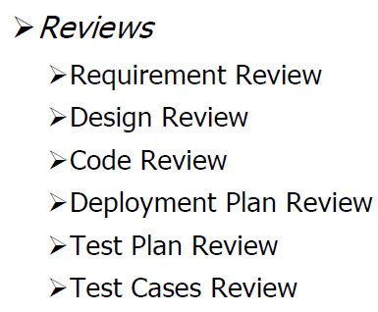
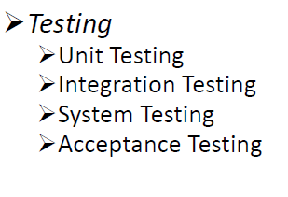
Quality Control

Slide 17
Objectives of SQA Activities
Software Development (Process-Oriented):
Functional and Technical Requirements: Ensure the software meets the specified requirements.
Managerial Requirements: Ensure the software is delivered on time and within budget.
Process Improvement: Continuously improve the development process to increase efficiency and reduce costs.
Software Maintenance:
Functional and Technical Requirements: Ensure that maintenance activities (e.g., bug fixes, updates) do not introduce new defects.
Managerial Requirements: Ensure that maintenance activities are completed on time and within budget.
Process Improvement: Improve the efficiency of maintenance activities to reduce costs and improve software quality.
Example: A software team uses SQA to:
Ensure that new features are thoroughly tested before release.
Monitor the development process to identify bottlenecks and improve efficiency.
Continuously update and improve the software based on user feedback.

Slide 18
SQA vs SQC
Process vs. Product:
SQA is focused on the process of developing software. It ensures that the methods, standards, and procedures used during development are effective and efficient.
SQC is focused on the product itself. It involves testing and inspecting the software to ensure it meets the required quality standards.
Prevention vs. Detection:
SQA is preventive. It aims to stop defects from occurring in the first place by improving the development process.
SQC is detective. It aims to find and fix defects after the software has been developed.
Timing:
SQA is applied throughout the entire software development lifecycle, from planning to maintenance.
SQC is applied after the software is developed, during the testing phase.
Responsibility:
SQA involves the entire team, including developers, testers, and managers, as everyone plays a role in ensuring the process is followed correctly.
SQC is primarily the responsibility of the testing team, who focus on identifying and fixing defects in the final product.

Slide 19
Aspect | Software Quality Assurance (SQA) | Software Quality Control (SQC)
Definition | A process-oriented approach to ensure that the software development process adheres to quality standards. | A product-oriented approach to identify defects in the final software product through testing and inspection.
Focus | Focuses on preventing defects by improving the development process. | Focuses on detecting defects in the finished product.
Objective | Ensures that the process used to develop the software is efficient, consistent, and produces high-quality results. | Ensures that the final product meets the specified requirements and is free of defects.
When Applied | Applied throughout the software development lifecycle (from planning to maintenance). | Applied after the software is developed, during the testing phase.
Activities | - Defining quality standards and processes. - Conducting audits and reviews. - Process improvement. | - Testing the software for bugs and defects. - Inspecting the product for compliance with requirements.
Responsibility | Entire team (developers, testers, managers) is responsible for SQA. | Testing team or quality control specialists are primarily responsible for SQC.
Prevention vs. Detection | Preventive approach: Aims to prevent defects by improving processes and ensuring adherence to standards. | Detective approach: Aims to identify and fix defects after the product is developed.
Examples | - Conducting code reviews. - Ensuring compliance with coding standards. - Process audits. | - Functional testing. - Performance testing. - User acceptance testing (UAT).
Tools | - Process management tools (e.g., JIRA, Trello). - Documentation tools (e.g., Confluence). | - Testing tools (e.g., Selenium, JUnit). - Bug tracking tools (e.g., Bugzilla, Mantis).
Outcome | Ensures that the development process is efficient, consistent, and produces high-quality software. | Ensures that the final product is free of defects and meets user requirements.
Key Metrics | - Process adherence. - Defect prevention rate. - Process improvement metrics. | - Defect detection rate. - Test coverage. - Bug fix rate.

Slide 20
Software Engineering
Software Engineering is the application of engineering principles to software development. It involves:
Systematic Approach: Following a structured process (e.g., requirements analysis, design, implementation, testing, maintenance).
Discipline: Adhering to best practices and standards.
Quantifiable Approach: Using metrics and data to measure and improve the development process.
Example: Building a software application is similar to building a bridge:
Requirements Analysis: Understanding what the bridge needs to do (e.g., span a river, support heavy traffic).
Design: Creating blueprints for the bridge.
Implementation: Constructing the bridge.
Testing: Ensuring the bridge is safe and functional.
Maintenance: Regularly inspecting and repairing the bridge to keep it in good condition.

